Slide 1

MadeiraCloud
A river runs through the cloud

Slide 2
About Us
- 3rd party SaaS for AWS
- Found at June, 2011
- Team of 5
- Beijing, China
- Angel Funded
“Madeira River is the Amazon’s largest and most important tributary” - Wikipedia

Slide 3
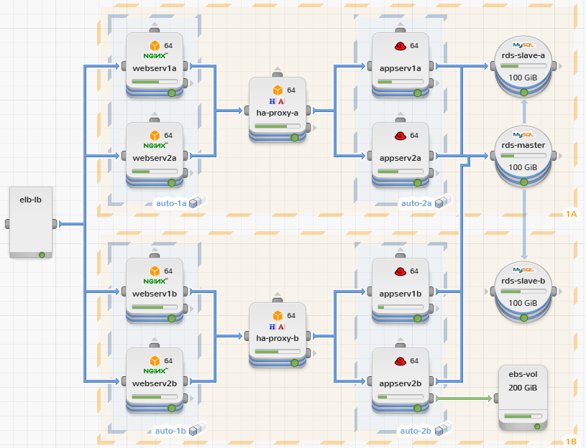
Visualize the cloud
- WYSIWYG IDE
- Live Architecture View
- Monitoring,
Management,
Analysis

Slide 4
Our Current Stack
- EBS instance for website/application hosting
- Prebaked AMI for quick provision
- SimpleDB for data storage
- SES for sending emails
- AutoScaling/ELB (not deployed yet)

Slide 5
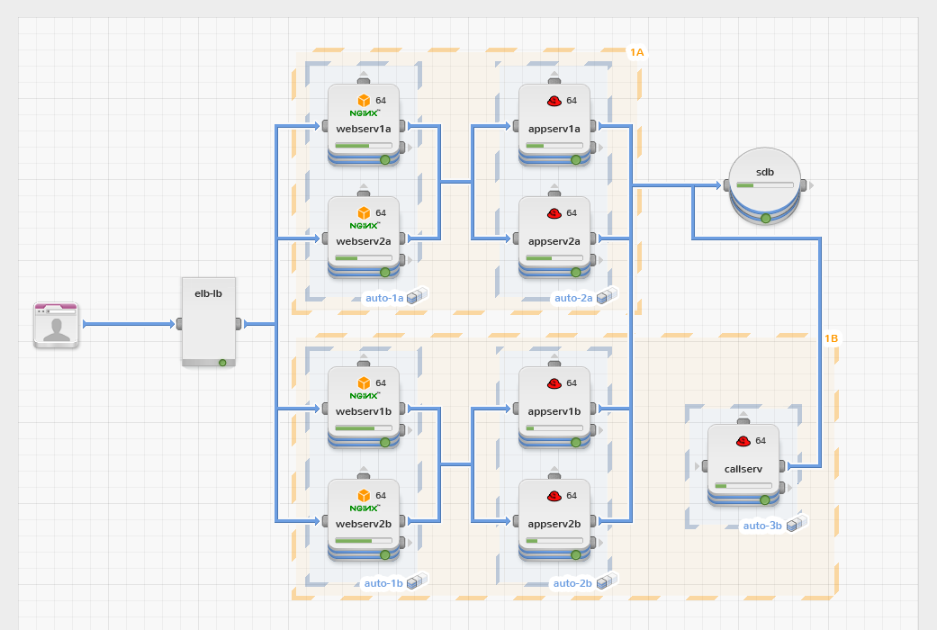

Slide 6
What we are going to deploy...

Slide 7
Security
- HTTPs for network
- Bcrypt (salt per user) for password encryption
- AES for user credential encryption
- master secret
- user specific token
- AES secret = our_own_algorithm(master secret, user token)
- No user data or ours in instance’s FS
- No credential or password in source code repo
- Turn off public SSH in production
only allow SSH from our “bridge” server

Slide 8
Q & A

